Slide 1
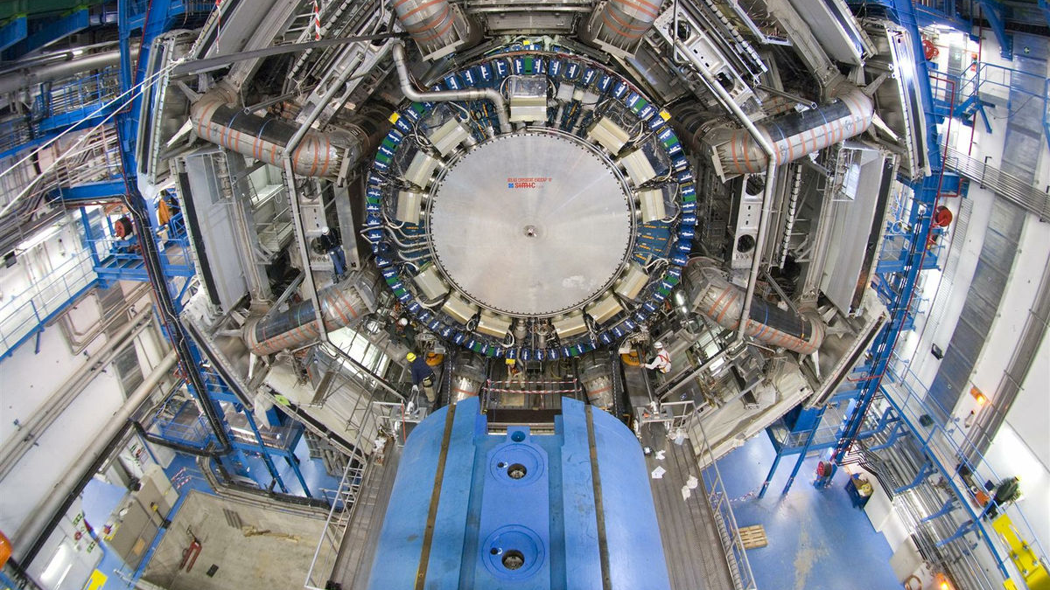


CIS Tech Update
Chicago Meeting, April 17th, 2023
Jacky Li and Peter Camporeale

Slide 2
Last Plan from Feb. to May
Since Feb. 6th, 2023…
Presentations: (We forgot to take photos, sadly)
Tile Week (Feb. 6-10) on CIS, L1Calo and Maintenance. Done.
TileCal Hardware & Operation Session (2023.2.8.) · Indico (cern.ch)
Tilecal Calibration, Data Preparation and Performance in Tile Week (2023.2.9.) · Indico (cern.ch)
Poster session in ATLAS Week (Feb. 13-17) on CIS and L1Calo. Done.
ATLAS Week (Feb 13-17) poster, ATLAS Tile Calorimeter Charge Injection System (CIS) and L1Calo - CERN Document Server
Maintenance: Done by Feb. 17.
Monthly CIS Constant updates, L1Calo and TUCS works: Resumed.
PSI visits:
PSI Zurich with Seyedali to help radiation testing on Feb. 8-9. Done.
Chicago SEE irradiation tests will be scheduled in March. Scheduled Apr. 20.
ATLAS Control Room Shifts: Fill in if needed.

Slide 3
Outline
Maintenance Results (Ended Feb. 17)
End-of-Year Recalibration Final Public Plots
Normal CIS Constant Updates
February 1 - February 28
March 1 - April 1
CIS Fitting Issues
L1Calo
DCS monitoring
Chicago PSI SEE testing preparation
Plans to July

Slide 4
Maintenance Results
The Maintenance Period started (Dec. 8, 2022), formally ended (Feb. 26, 2023).
Physical Maintenance on Tile ended (Feb. 17, 2023).
 | Identified | Fixed | Fixed Rate
EBA | 18 | 6 | 33%
EBC | 20 | 5 | 25%
LBA | 15 | 9 | 60%
LBC | 14 | 9 | 64%
Total | 66 | 28 | 32%
Channel info:
45 channels unreachable in maintenance. (0.2% of the total 19704 channels)
Cooling info:
PPV cycle 479 mins
Maintenance General Information
(of modules that needed action)

Slide 5
2. End-of-Year Recalibration
Every year, when data taking is over, it's time to prepare CIS constants for reprocessing.
Ideology:
We want to guarantee that we have the best possible CIS constant year round. There may not be one value for the entire run period; there could be multiple different stable values over the course of many months
Any change in the CIS constant by more than 0.5% is detected and stored
During normal monthly CIS calibrations, we assign ONE constant for each channel based on the calibration runs of that month. This updates the future database value for the next month.

Slide 6
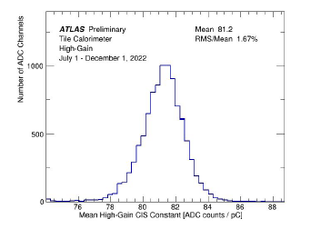
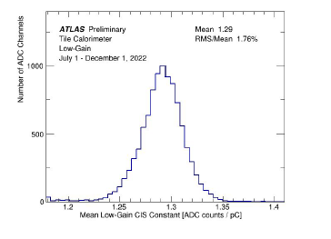
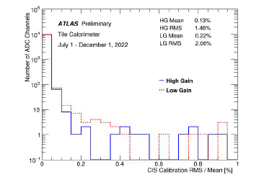
2.a. CIS Constant Distributions
Run 3
CIS constant RMS/Mean of High-Gain, Low-Gain
High Gain Constant Distribution
Low Gain Constant Distribution

Slide 7
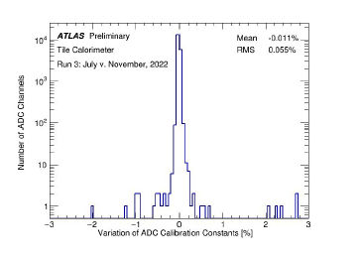
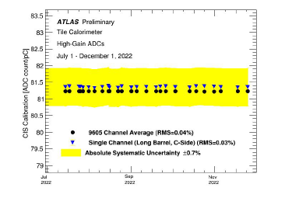
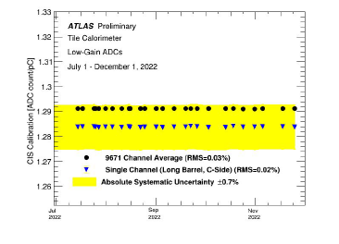
2.b. CIS Constant Long-Term Stability
Run 3
CIS Calibration Average over Run 3 in High Gain
CIS Calibration Average over Run 3 in Low Gain
CIS Constant variation percentage over Run 3 in all channels

Slide 8
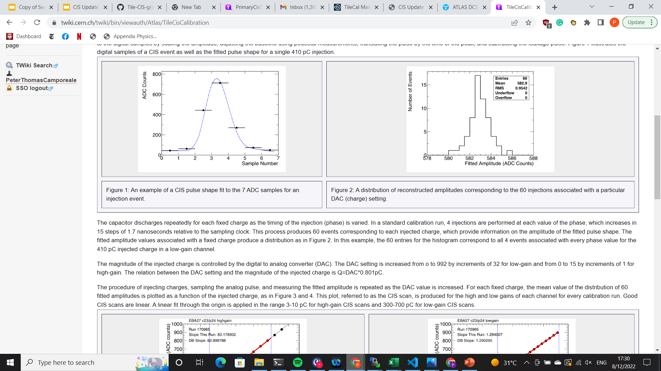
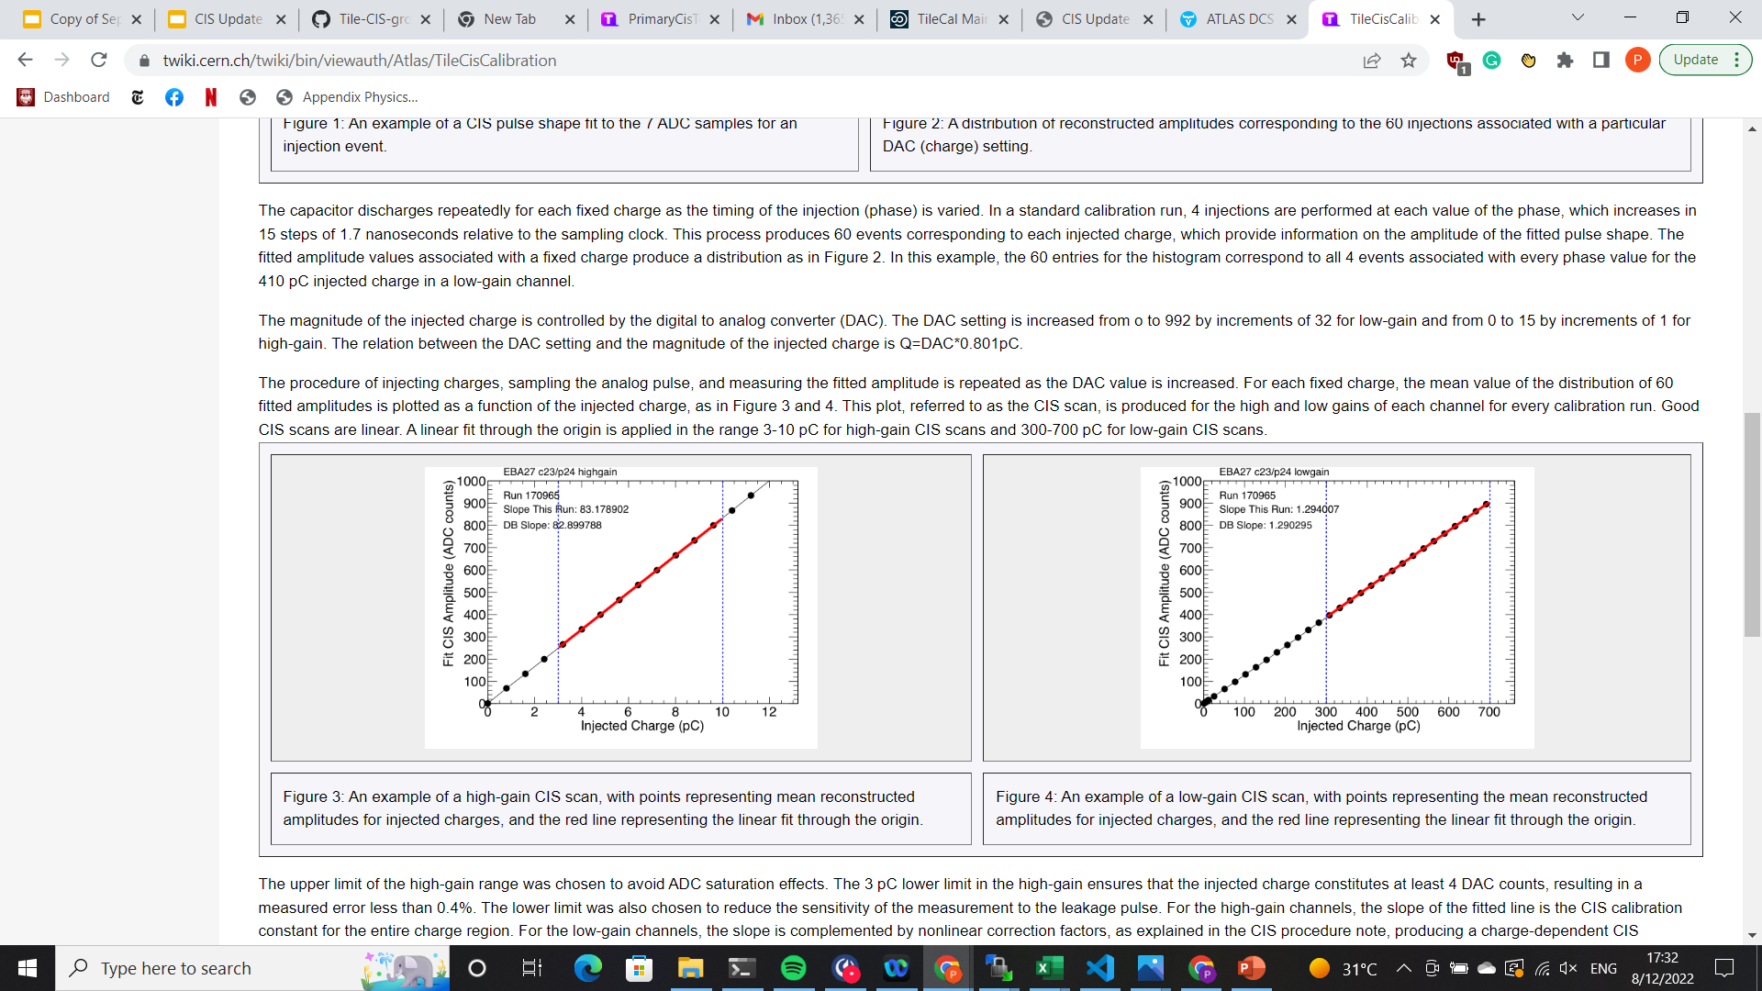
1.a. Introduction of CIS
Use known input charge to calibrate ADC counts of front-end electronics
3-in-1 cards contain 5,100 pF capacitors
Input known charge 60 times, sample each pulse 7 times 🡪 pulse amplitude
Fit mean pulse amplitude (in ADC counts) to injected charge
CIS calibration runs are taken between ATLAS runs, roughly 3 times per week
Use TUCS to analyze data for recent runs and identify DQ issues in channels
Monitor individual channels: drifting, high scatter, half-gain?
Monitor overall performance: percent change, long-term stability, RMS/mean
Upload new constants to database

Slide 9
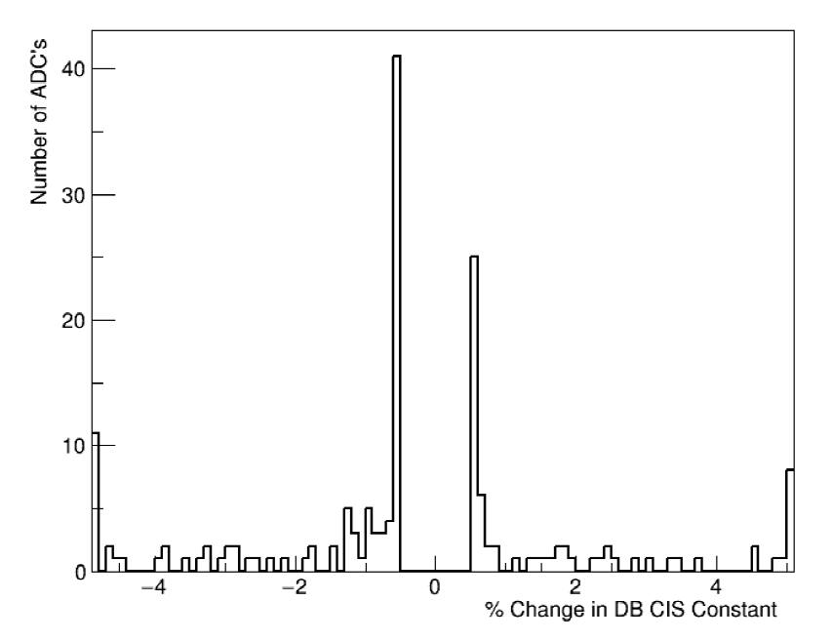
3.a. CIS Constant Update:
February 1 - February 28
CIS runs from February 1 - February 28
19704 channels in update
(Recalibration of ALL channels)
19662 Good (>1 successful
calibration)
18 Masked
24 Affected
19 >5% change
Runs excluded: 443840 444474
Runs used (13): 442620 442775 442791 442820 442935 443018 443364 443414 443831 443835 444001 444007 444633
Distribution of CIS constants for the entire detector. The histogram omits channels for which change is less than 0.5% since the last update.

Slide 10
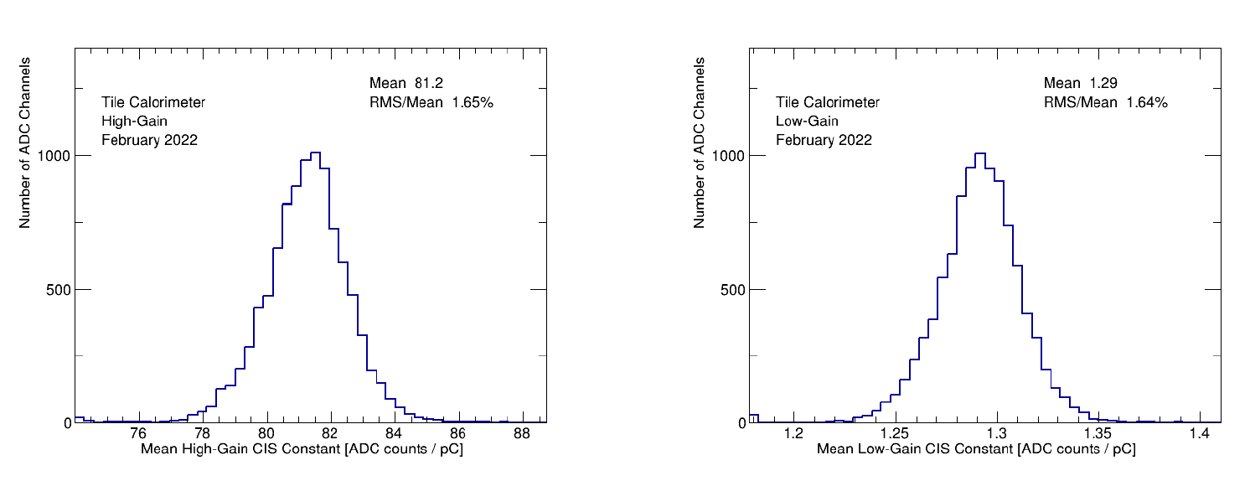
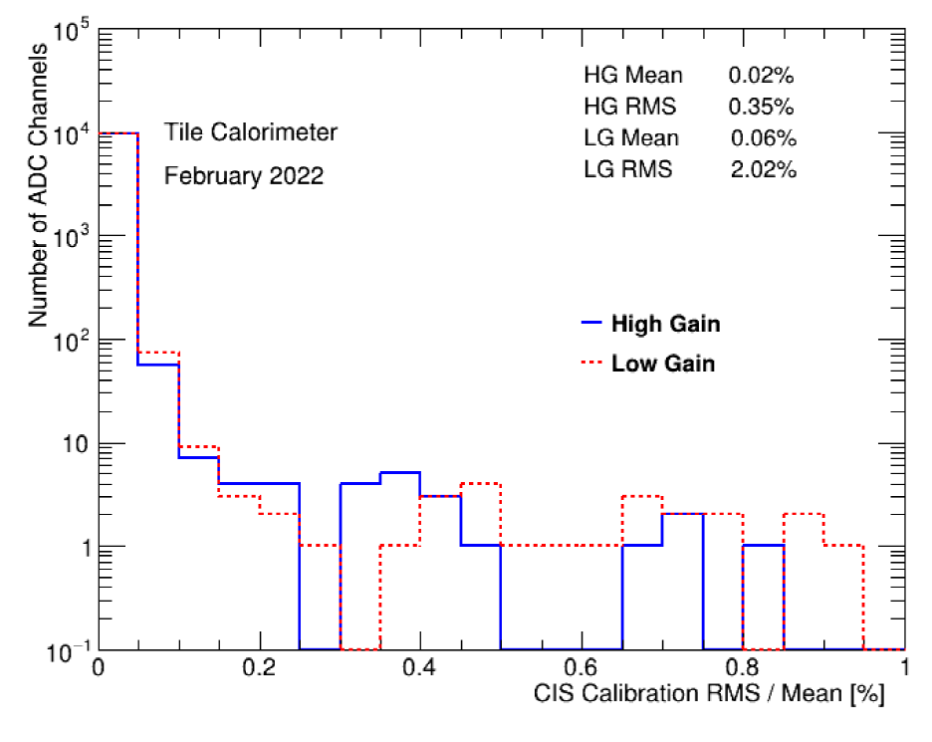
3.a. CIS Constant Distributions:
February 1 - February 28
RMS/MEan distribution of CIS constant. The overflow (cut off) is because of modules being off and this affecting the calculation.
Distribution of Mean HG CIS constants
Distribution of Mean LG CIS constants

Slide 11
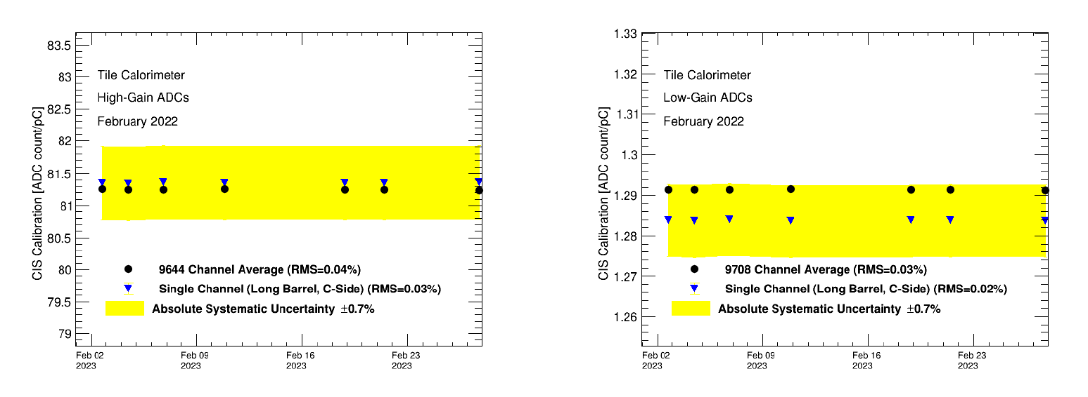
3.a. Detector Time Stability:
February 1 - February 28
CIS Calibration Average in High Gain
CIS Calibration Average in Low Gain

Slide 12
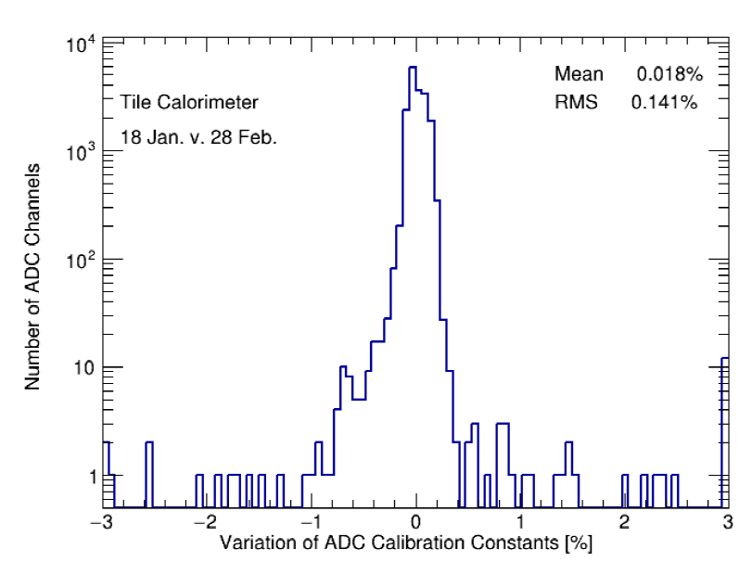
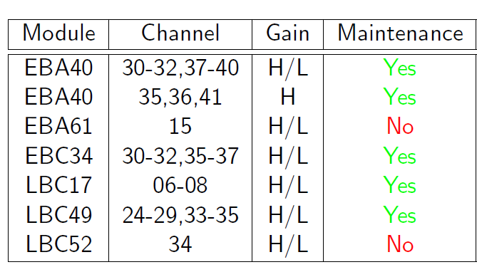
3.a. CIS Constant Long-Term Stability:
February 1 - February 28
These channels in the overflow bins are added to the above recalibration list and recalibrated.
Number of Channels vs. Percentage of CIS constant change

Slide 13
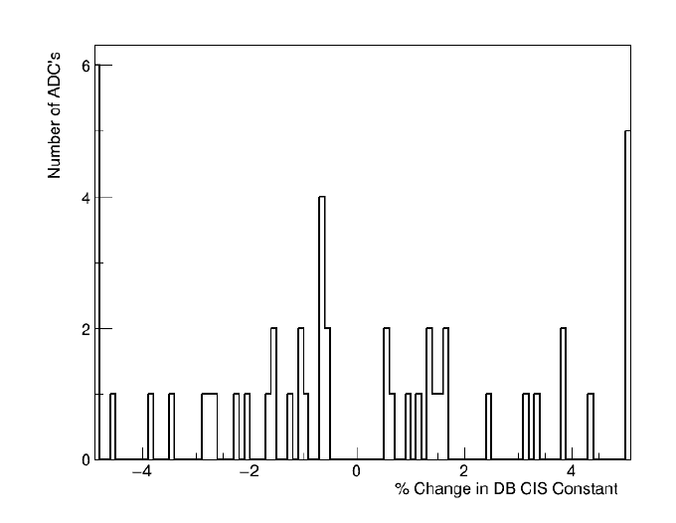
3.b. CIS Constant Update:
March 1 - April 1
CIS runs from February 1 - February 28
62 channels in update
(Recalibration of ALL channels)
31 Good (>1 successful calibration)
12 Masked
19 Affected
10 >5% change
Runs excluded (5): 445197 445634 447564 447641 447987
Runs used (10): 444983 445096 445338 445749 445929 446573 446738 447390 447442 447551
Distribution of CIS constants for the entire detector. The histogram omits channels for which change is less than 0.5% since the last update.

Slide 14
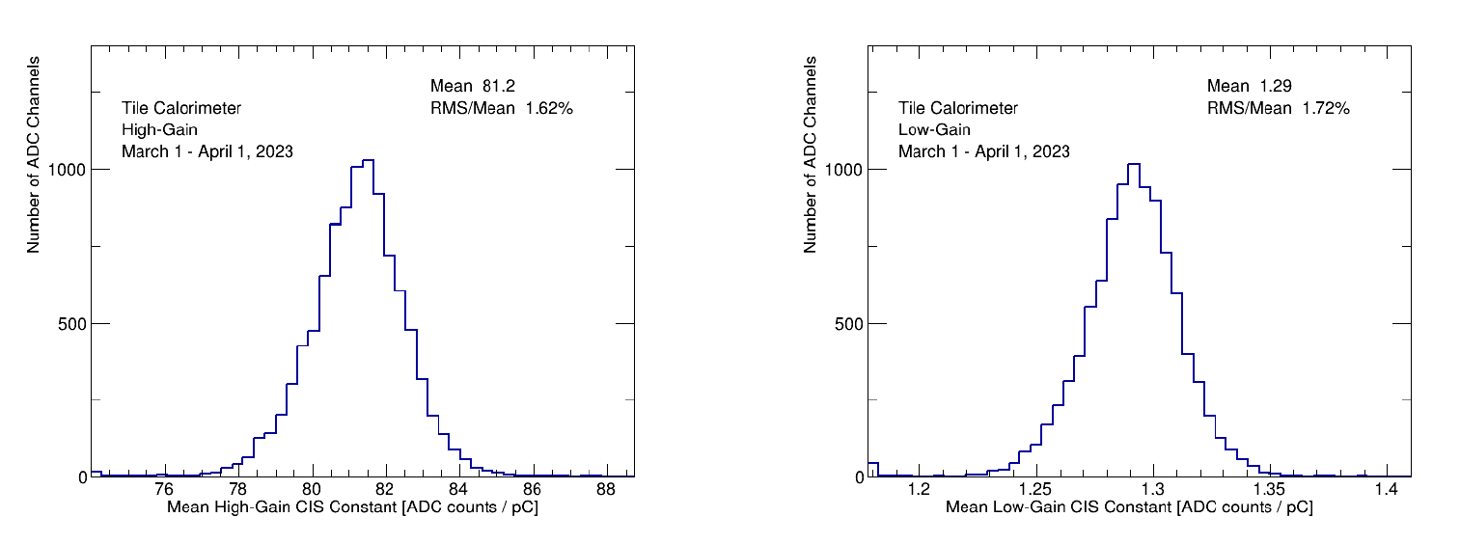
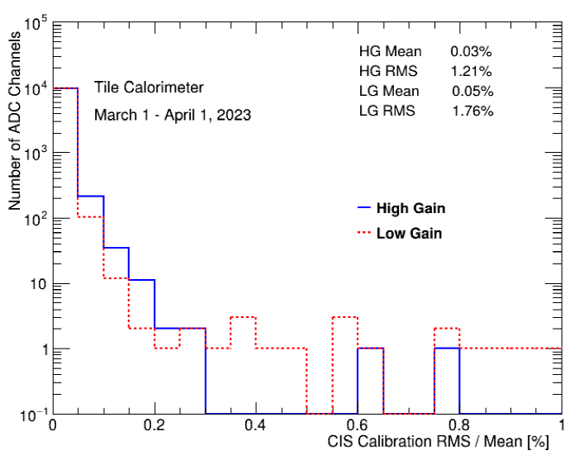
3.b. CIS Constant Distributions:
March 1 - April 1
RMS/MEan distribution of CIS constant. The overflow (cut off) is because of modules being off and this affecting the calculation.
Distribution of Mean HG CIS constants
Distribution of Mean LG CIS constants

Slide 15
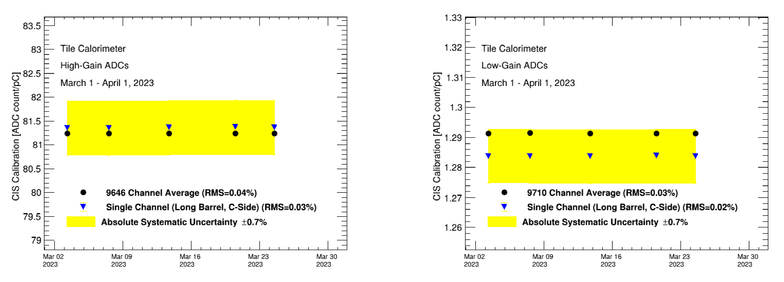
3.b. Detector Time Stability:
March 1 - April 1
CIS Calibration Average in High Gain
CIS Calibration Average in Low Gain

Slide 16
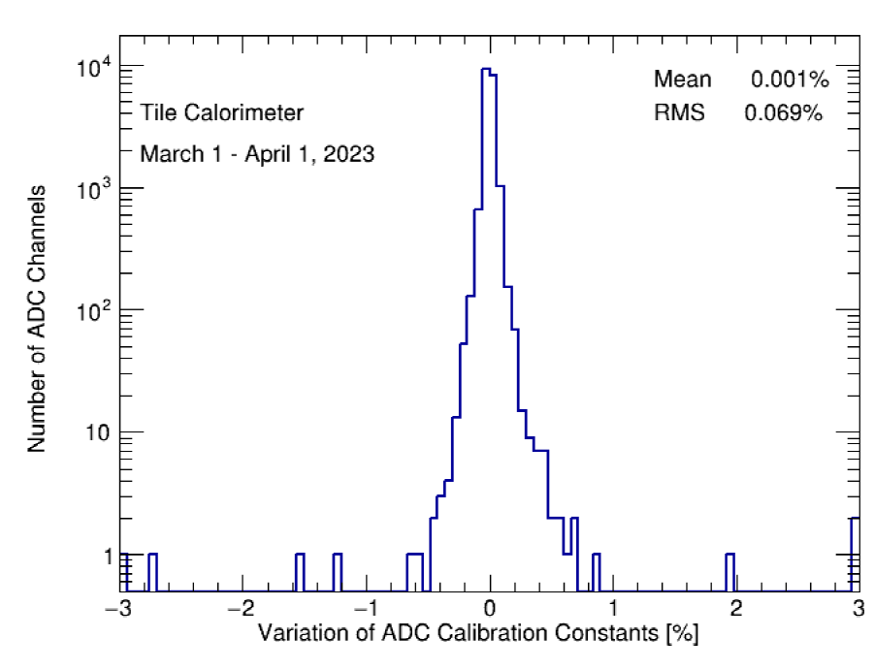
3.b. CIS Constant Long-Term Stability:
March 1 - April 1
EBA m16 c17 highgain (-4.1%)
LBC m10 c37 highgain/lowgain (4.2%)
Number of Channels vs. Percentage of CIS constant change

Slide 17
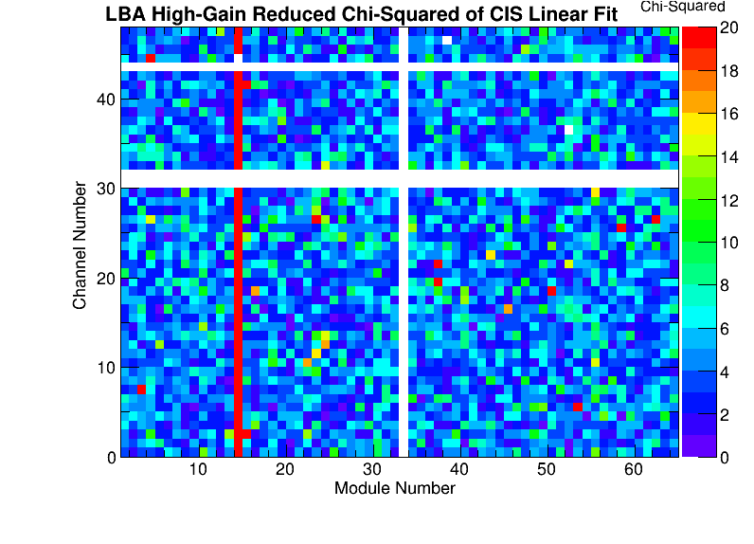
4. CIS Fitting Issues
LBA14 pulse shape is different due to different electronics
Previous CIS calibrations have been using the default pulse shape, reducing the quality of fit
We’ve developed some tools for understanding the fit quality of pC v. ADC counts (added a new worker to Tucs Chi2Heatmap.py)
As a temporary fix to Tucs, we’ve made some Python scripts to plot ADC v. pC and data-fit
A recent talk on this subject: here

Slide 18
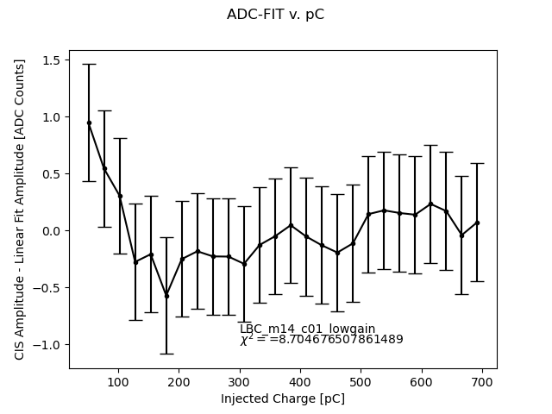
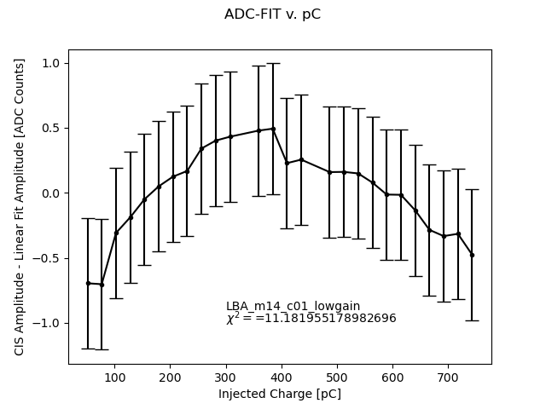
4. CIS Fitting Issues
Data-Fit for LBA14 sample channel (LBA_m14_c01_lowgain) and a selected legacy channel (LBC_m14_c01_lowgain)

Slide 19
4. CIS Fitting Issues
Current Problems (in progress)
Currently, one problem is that reconstructing runs in Athena produces no events for CIS in LBA14, even for runs before YETS
Demonstrator is now set to DEFAULT meaning its CIs constant is just the previous one stored in the database (there’s no answer yet about how this is being updated)
When these are solved, we can inspect other aspects of CIS fitting such as changing the fit range (for demonstrator)
It has been possible to do some investigating through Tucs

Slide 20
5. L1Calo+Tile
We presented a summary of PMT scans and work on Tile+L1Calo operation at during Tile Week in February. We continue to monitor PMT scans to check quality of Tile channels in L1Calo.
Previous operational changes for data taking 2023 are implemented and ready for data-taking 2023
ERS messages containing Tile tower ID
Tile Trigger Monitor in Data Quality Monitoring Display (DQMD) in the control room
Upcoming changes to Trigger Monitor (yet to be deployed at P1):
Setting a low rate threshold to give a YELLOW warning to shifters (need input from L1Calo experts)
Setting a high rate threshold to give a RED warning (set based on average rate of all towers)
(At the moment, the display is always GREEN, so they do not prompt any action)

Slide 21
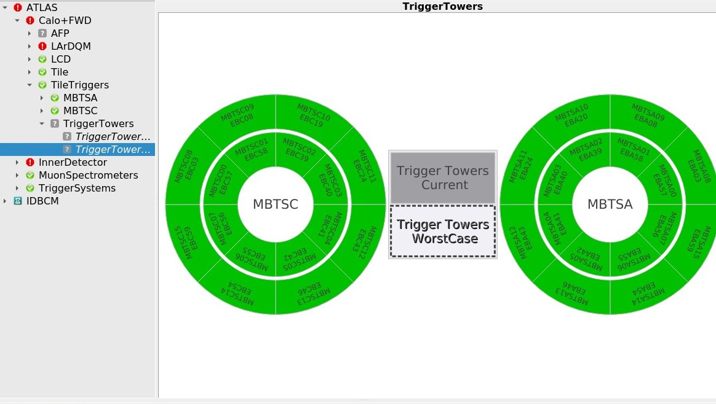
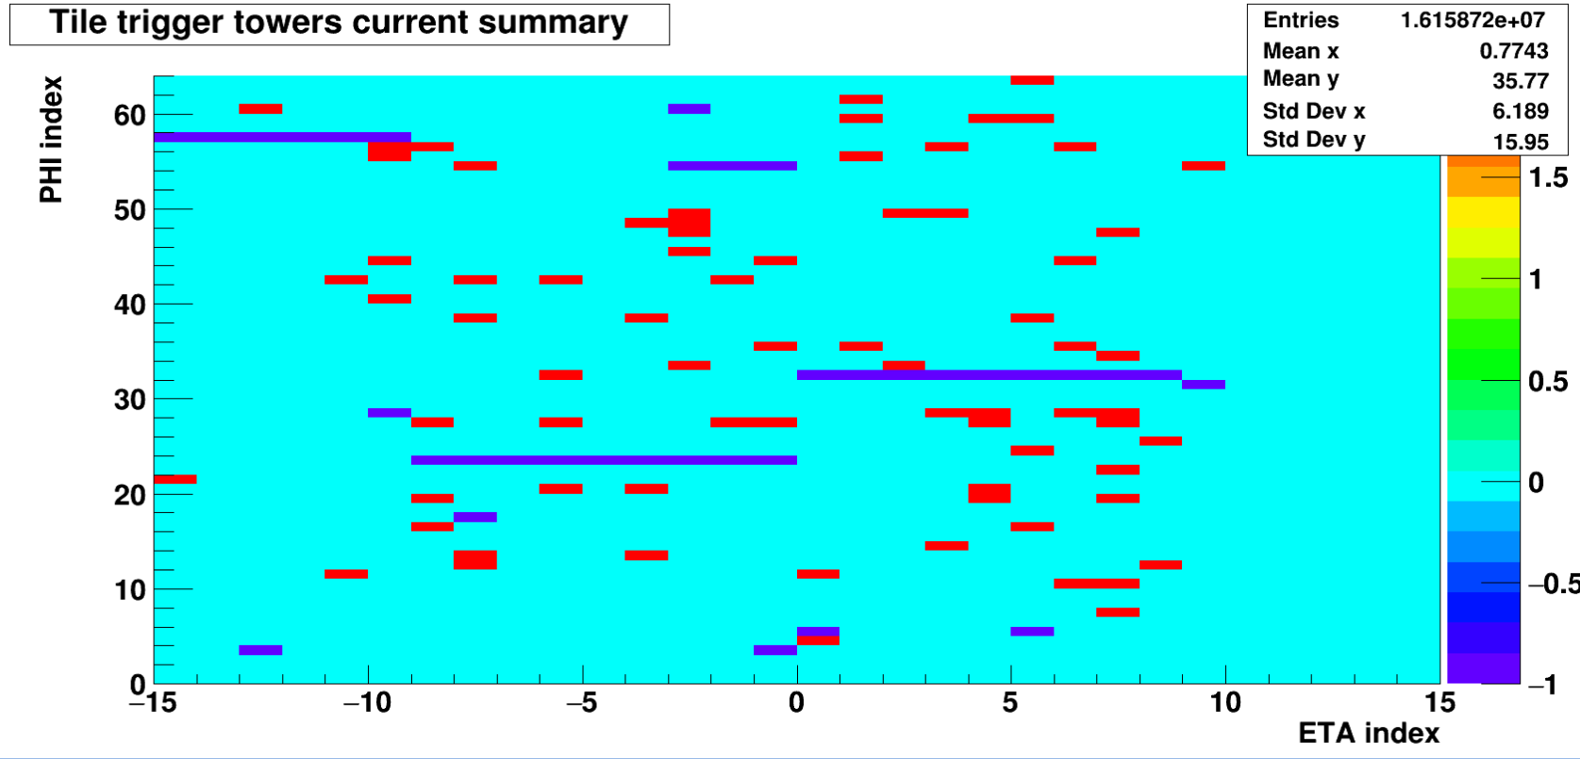
5. a. ATLAS Control Room
Low rate monitor: -2: no beam -1 : tower not initialized/off 0 :NORMAL state 1: WARNING state 2: LOW RATE state. These values are set according to the following formula:
State = Fast-Smoothed Mean Rate/Reference Mean Rate ⋚ Threshold

Slide 22
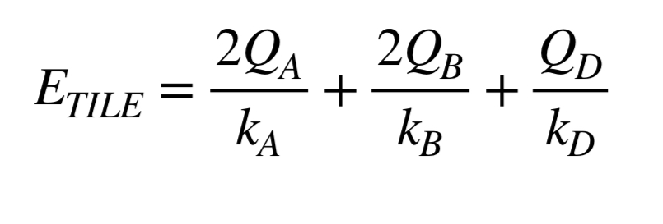
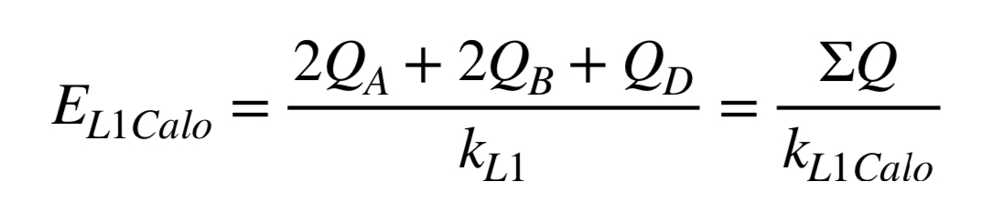
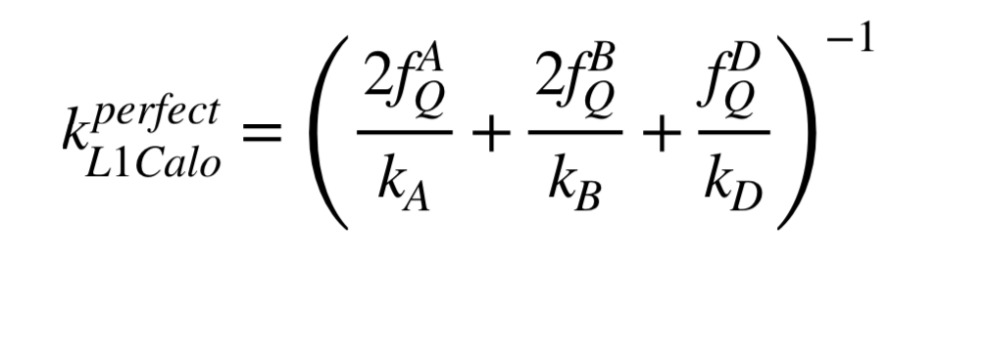
5.b. New Calibration Procedure
Goal: Injecting charge at constant energy not constant charge to reduce the spread in L1Calo calibration constant
First, we need to be able to turn off/on selected PMTs in a tower (I.e. dead PMTs should not contribute to tower energy)
Next, we need to modify the charge for each PMT so it is no longer fixed. Eventually, it needs to account for PMT drift and scintillator degradation, too
This has turned out to be quite a mess: Understanding the calibration scripts is not easy
(Equations taken from L1Calo meeting )

Slide 23
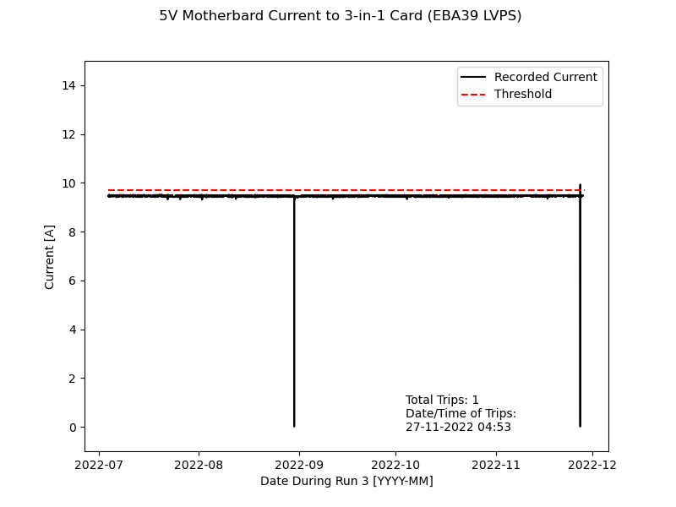
6. DCS Monitoring
DCS keeps track of trips and power cycles for LVPS modules
Trip information is stored at Point 1 (and distinguished from other times when current is sent to 0)
Plotting of trips in problematic modules (good for checking Harting connectors during next maintenance campaign)
Occasionally, threshold are adjusted to prevent frequent tripping

Slide 24
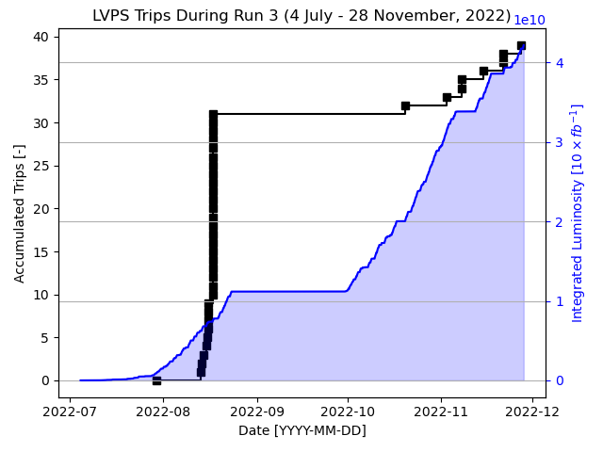
6. DCS Monitoring
The number of trips tracks the total integrated luminosity delivered
In total, there are 8 distinct LVPS’s that have tripped, and most trip only once
Trips of LVPS are used to reset the current sent to 3-in-1 cards so they do not burn

Slide 25
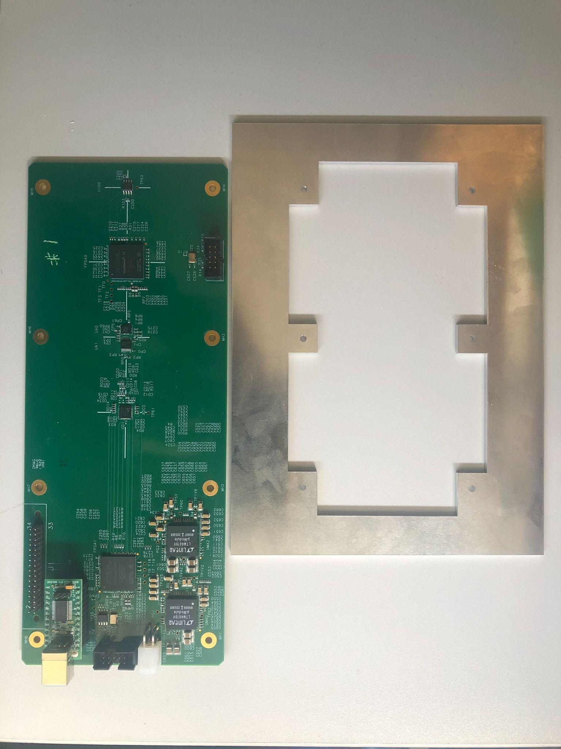
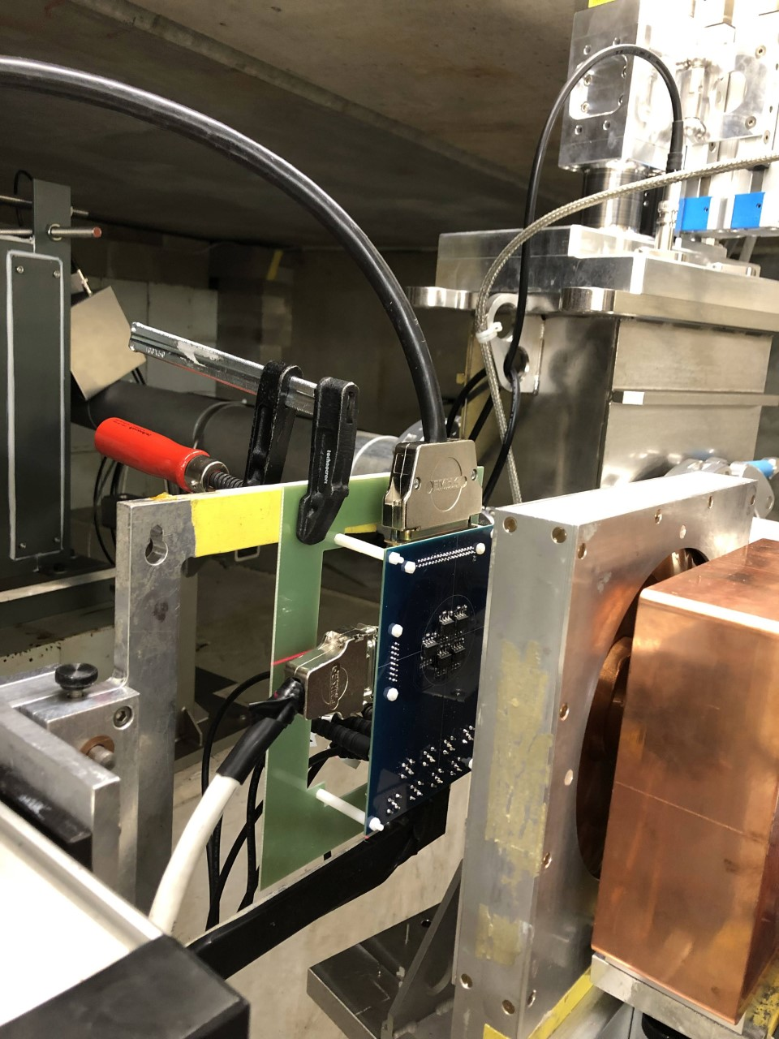
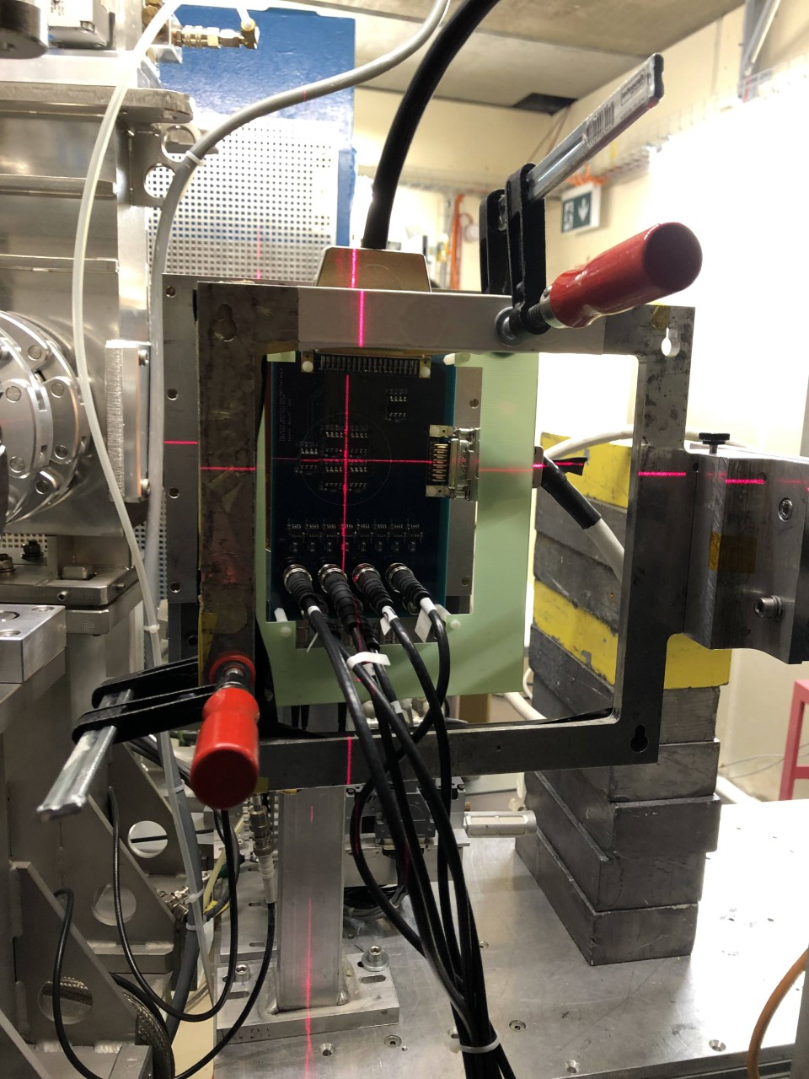
7. Chicago PSI SEE testing preparation
SEE lot testing board & newly made mounting frame
The testing structure at PSI, photos from Feb. 8-9 test

Slide 26
8. Plans to July
Chicago SEE lot testing at PSI:
Scheduled on Apr. 20-21.
DCS monitoring
Documentations
Update Twiki: life (e.g. insurance), code scripts, CIS tech introduction & repo, etc.
Training materials for the next generation of CIS techs
Monthly CIS Constant updates, L1Calo and TUCS works:
CIS fitting issue
L1Calo new calibration strategy
TUCS debug
Currently, only recovered the basic functions to perform updates
A lot of scripts for checking edge cases are very outdated and does not compile
Expectation:
may not be able to finish all, but can be taken over by next generation of Techs

Slide 27
Any Questions?
Summary of Contents:
Maintenance Results (Ended Feb. 17)
End-of-Year Recalibration Final Public Plots
Normal CIS Constant Updates
February 1 - February 28
March 1 - April 1
CIS Fitting Issues
L1Calo
DCS monitoring
Chicago SEE testing
Plans to July

Slide 28
Thank you for your attention ☺

